Slide 1
Webs that Work
Fall User Group Meeting

Slide 2
Introductions
WNYRIC - Webs that Work Team
  Rob Warchocki - Supervisor of Web Site & Messaging Services
  Becky Zdon – Implementation Specialist
  Mindy Gigantelli - Application Support/Training
  Gloria Queeno-Chamberlain - Application Support/Training
  Chris Poette, John Marren, and Eric Thornton – Core Hosted Application Technical Team (CHATT)

Slide 3
Introductions
Schoolwires
  Vicki Jacobs – Client Success Representative

Slide 4
Agenda
    Service Updates
  Support Reminders, Training Reminders, and Service Offerings!
Schoolwires Updates
  Review of 2.6, 2.7 and upcoming 2.8 release!
  What’s new with Schoolwires?
Innovative Ideas
Webs that Work Demo Site
  District Group Discussion

Slide 5
Service Updates
Support Reminders
  Email wtw@e1b.org for website support
    If you email a member of the team directly, please copy wtw@e1b.org to prevent delays if that team member is unavailable.
  Provide as much information as possible, such as:
    Browser and version
    Link to problem area, or exact location
  You can also call the WNYRIC Service Desk for website support at (716) 821-7171. They will connect you with the first available WTW team member.

Slide 6
Service Updates
Support Reminders (cont.)
  All support cases should be funneled through the appropriate district website contact.
    Example: Site Director or Subsite Director.
    Section editors should not contact the WTW team directly for support.
    Do not contact Schoolwires directly. They will route support cases back to the WTW team which can cause delays.
  Need service or pricing information?
    Web: www.wnyric.org, Our Services/Service Directory
    Or Email: rzdon@e1b.org/call: (716) 821-7355

Slide 7
Service Updates
Training Reminders
  C2 Customers: 2 days per year
  C2Essential Customers: 2.5 days per year.
  Training hours do not carry forward from one year to the next
  To request a training:
    Call/email Becky Zdon at 821-7355 or rzdon@e1b.org
    wnyric.schoolwires.com/trainingrequest
  Refer to the Training Service Level Agreement for detailed guidelines
    http://wnyric.schoolwires.com/training

Slide 8
Service Updates
Important Training Guidelines
  District will be charged a minimum of a ½ day for each on-site training.
  Class size should be no more than 12 students.
  Students with similar skill levels should be grouped together.
  For full day training sessions, a 30 minute lunch is required for the instructor.
  If you require more than 1 instructor onsite, we will calculate the amount of time you will be charged accordingly.
    Example: 2 trainers for ½ day = full day training
  CSLO days can also be used for teacher training

Slide 9
Service Updates
Current Training Offerings: wnyric.schoolwires.com/trainingagendas
Section Editor – Level 1& 2
  Training CAN make a difference!
Homepage & Calendar Editor
Training for New Site Directors
Custom Site Director Training
C2 Essential Orientation for Site Directors
Training for New Subsite Directors
Custom Subsite Director Training

Slide 10
Service Updates
*NEW Training Offerings! Web Academies:
All About Apps
Fabulous Forms & Super Surveys
Self-Service or Mini Car Wash

Slide 11
Service Updates
Service Offerings:
  Webmaster Service
  Car Wash – Full Service, Self Service, Mini
  Premium Video App
  C2 Mobile Communications App
    New Version, New Pricing!
    Southwestern, Franklinville, Lockport, Wellsville, Salamanca
  Template Library - Change the look of your website any time you want.
    Standard, Express, MyWay, or MyWay Premium templates
Notes:
Webmaster Service – If a district needs help maintaining the website (not creating content), this service can help. Days or specific block of time.
PVA - your videos can be created in any file or format, they can be viewed on any device with the click of a button, and viewers don’t have to install plug-ins to watch! Athletic Events, Special Events, Board Meetings, & PTO Meetings.

Slide 12
Service Updates
Service Offerings (cont.)
  C2 Essentials
    17 Districts & counting!
  Secure LDAP Connector
    13 Districts & counting!
  Synergy
  Sections (Flex Sites) – sold in bundles of 100
  Storage – sold in increments of 10 gb’s

Slide 13
Service Updates
Congratulations to North Tonawanda
  The North Tonawanda district website won the "Grabbing Parents' Attention with Web Graphics and News Bites" award from NYSPRA. Their use of social media, homepage shortcuts, announcements, graphics, news items, and interesting layouts puts them at the top of the class!

Slide 14
Schoolwires Updates
Vicki Jacobs, Client Success Representative
Presentation

Slide 15
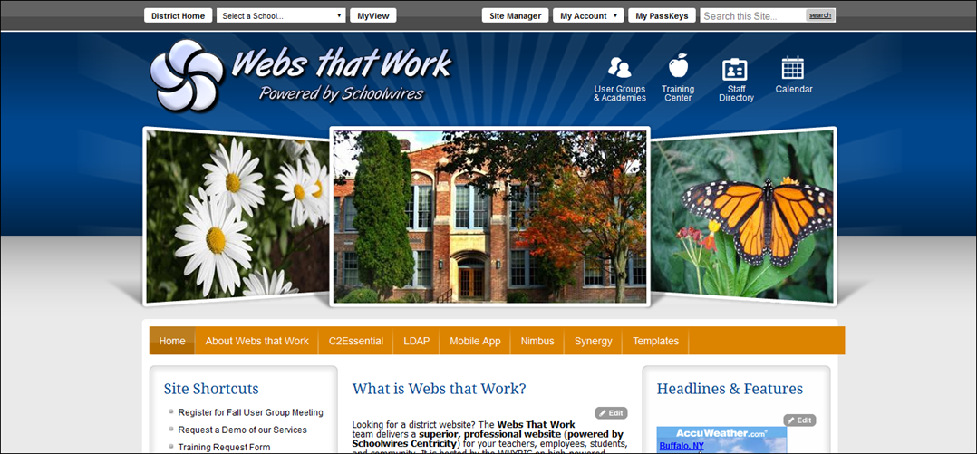
Webs that Work Demo
http://wnyric.schoolwires.com

Slide 16
Innovative Ideas
Lockport CSD – Online Student Run Paper
  Student run online newspaper with the ability to comment, rate, share, and tweet Towpath articles. Highlights include, sports, poetry, short stories, holiday-grams and more!
  http://www.lockportschools.org/ghoulgrams
Franklinville CSD – Forms Minibase
  View all district forms in one centralized location, or by a specific department using a filtered view!
  Forms Minibase
  Filtered View – Cafeteria Forms

Slide 17
Innovative Ideas
Lansing CSD – Homework Bag
  Parents can request homework and notify the teacher when their children are going to miss school. There have been almost 300 requests for homework since implementation (2014).
Lakeshore CSD – China Exchange
  A special area of the website was reserved to document a trip to China, taken by students of Lakeshore CSD. Jeff Barnes and his students had fun posting lots of pictures, descriptions of daily activities, and even personal messages to their families! This is a great idea for any school that is planning a student trip.

Slide 18
Innovative Ideas
Tonawanda CSD/Pioneer CSD – Symbaloo
  A visual bookmarking tool that makes it simple and fun to organize links to online resources. Great for library sites, elementary student use and as an alternative to tables. Mobile App is available!
Pioneer CSD – Ask the Teacher
  The Math Department developed a very creative method of answering questions from students/parents. An online form collects questions, which are then answered through the Q & A App.

Slide 19
Innovative Ideas
Akron CSD – “Mini” Staff Directory
  Use a filtered view of your Staff Directory to spruce up a department homepage. Full Directory.
Newfane CSD – Channel Homepage for the NECC. Advantages include:
  Allows for the set up of a “Homepage” for any area of the website. (Example: Schools, Athletics)
  More Mobile “Friendly” navigation
  When a user clicks the channel, they will be directed to the homepage, rather than the first page of the first section.

Slide 20
Innovative Ideas
Westfield CSD - Food Lab Report Form
  Kathy Monroe, Family & Consumer Science teacher at Westfield CSD, takes advantage of the Form & Survey tool to make lab reports easier to complete, receive, and grade. She also found a creative way to identify which question links to which Common Core Learning Standard.
Creative use of Apps– Exam Schedules
  Experiment with different apps! Try using the Lunch Menu app to post exam schedules like Westfield CSD.

Slide 21
District Q & A - Topics
Topic 1: How are you using the district website with applications such as, Google Apps, My Big Campus, and other tools where there is overlap in functionality? What are the requirements for Teachers?
Topic 2: Looking ahead to budget season, is anyone using the website features to do anything innovative to increase community engagement, share information, and promote legislative advocacy?
Topic 3: Share your tips to make the district homepage easy to navigate and intuitive.

