Slide 1
Schoolwires Updates
Vicki Jacobs
October 22, 2014

Slide 2
TOPICS
Centricity2 2.6 Release Highlights
Centricity2 2.7 Release Highlights
What’s new with Schoolwires
  Schoolwires Blog
  Help Materials
    Updated Share Site
      Help Center
      Curated Search
    Social Media
  Centricity2 2.8 Release Highlights

Slide 3
Centricity2 2.6 Release Highlights
New mobile friendly features for Centricity2.
  New Gallery Type of ‘JavaScript’
  Content Browser displays as an off-canvas menu
New password strength indicator in self-registration, edit account on the end-user website and add a new user and reset password in Site Manager.
Resolution of various defects, including those related to the calendar, end-user website, security and performance… read the release notes for details.
2.6 release notes – available on the SHARE site
Notes:
New Gallery type of JavaScript has been added and is now the default setting for any new photo galleries that are created.
The Content Browser display as an off-canvas menu when viewed on mobile devices, including tablets and even on a desktop computer when the browser window is not fully expanded.

Slide 4
Centricity2 2.7 Release Highlights
Contains three new adaptive apps: Heading, Content, Image
Contains two new page types: Blank & Basic (contains three new adaptive apps)
Contains two updated page types:
  Teacher Homepage - Heading, Content, Announcements & Upcoming Events Apps
  Department Homepage - Heading, Welcome {Content}, Contact Us {Content} & Link Library Apps
Enhanced the user experience for Broadcast E-Alerts & added push notifications that work with your Mobile Communications App if your district has one.
Premium Video App makes its debut with this release of Centricity2.
  Available for an additional fee.
Added Chrome & IE11 Site Manager support with this release.
Resolved various defects... read the release notes for details.
2.7 release notes and 2.7 release webinar - available on the SHARE site
Notes:
Blank Page Type - blank canvas, single column layout no apps included.
Basic Page Type - keep things simple with image, heading & content apps in a 2 column layout.
The content app, is a far simpler space to work with – especially for those who have little experience with websites. The heading app is helpful for people that have trouble remembering to go into the app options and showing the app title. The image app is a basic form of adding an image to a page, and getting that image to be placed in the entire portion of the layout that you have chosen for it to live in.
Examples:
http://www.scasd.org/Page/19181
http://www.scasd.org/Page/20038
http://c2.swtrain4.schoolwires.net/Page/2865
55% of U.S. adults have a smartphone; 42% of U.S. adults own a tablet computer; 63% of adult cell owners use their phones to go online; while 34% of mobile internet users go online mostly using their phones, and not using some other device such as a desktop or laptop computer. Good reason to start thinking about adaptive content .

Slide 5
Helpful Information
Visitors to your website are looking for information. They want it on their…
desktops | laptops | tablets | smartphones
So you need your content (information) – to be adaptive. Your content should display easily and effectively on any device or screen—with minimal pinching and zooming.
  Remember that some page layouts are better suited for certain apps or combinations of apps than others.
  This document includes a chart illustrating our layout and app recommendations. Best Practices for Apps on Pages
Other documentation that is helpful…on ‘How Do I’ tab
  Pages and Apps Help Card
  App and Page Types Help Card
Using different app and page types keeps your sections interesting and organized!
Notes:
Keep in mind that Page Types are a starting point as you create your pages and that APP’s are the content building blocks of pages. You have the ability to place a single app or multiple apps on a page and then determine the order you want them to appear in.
Remember, each app offers different functionality and can help you keep your pages interesting and organized. You can share your apps with others allowing them to display your shared apps on their pages; however, they cannot edit or delete them.
Choosing the right app or combination of apps and the right page layouts will help you provide your visitors with adaptive content that automatically responds to the type of device accessing the information and keep your pages fresh and engaging.
An adaptive website adjusts the structure, content, or presentation of information in response to measured user interaction with the site, with the objective of optimizing future user interactions. Adaptive websites "are web sites that automatically improve their organization and presentation by learning from their user access patterns."

Slide 6
What’s new with Schoolwires – Schoolwires Blog
Join the Schoolwires Blog to get the latest information about…
  product releases
  latest trends in K-12 education technology
  important tips you should know about parent engagement, school-home communication, branding/marketing your district, classroom collaboration, and much more
Become a guest blogger
  email: wired_blog@schoolwires.com
Check out the Schoolwires Blog: http://blog.schoolwires.com/

Slide 7
What’s new with Schoolwires – Help Materials
Where Can You Locate Help Materials?
  How Do I tab in Site Manager
  Share Community & Support Site
  Share Help Center
  Social Media
?
?
?
Notes:
How Do I tab (available at every workspace) & Share Community & Support Network
Share site features seasonal content on the homepage and provides Quick links to other important information (click to open share)

Slide 8
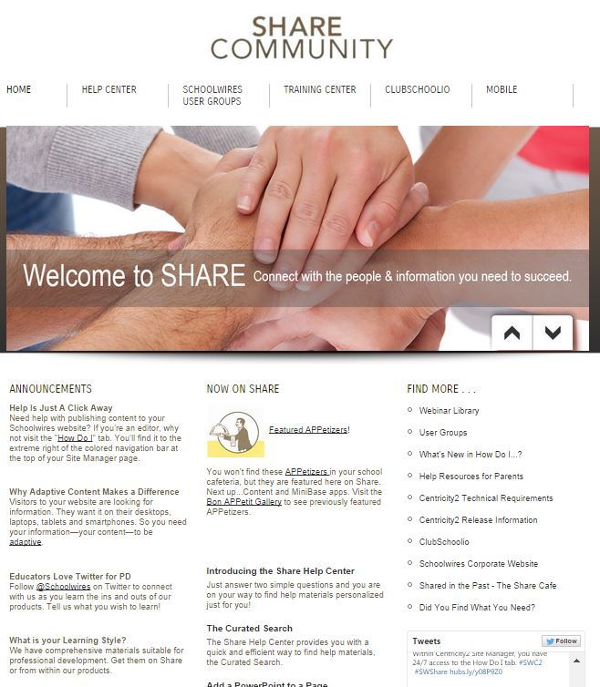

What’s new with Schoolwires – Help Materials: Updated Share Site
(help.schoolwires.com)
Written Materials
  Articles
  Guides
  Help Cards
  Workbooks
  APPetizers
  Share Café
Video Materials
  Comprehensive Tutorials
  Short Tutorials
  Tutorial Series
  Webinars
  Online Courses
Notes:
Schoolwires Technical Communications is continually creating and updating print and video help materials.
We have over 700 materials posted today.

Slide 9
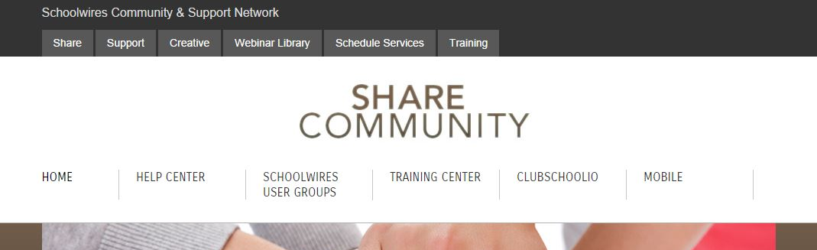
What’s new with Schoolwires – Help Materials: Updated Share Site -
Help Center (help.schoolwires.com/helpcenter)
The Share homepage is your hub to locate all the information you need.
The Help Center channel is located on the Share homepage.

Slide 10
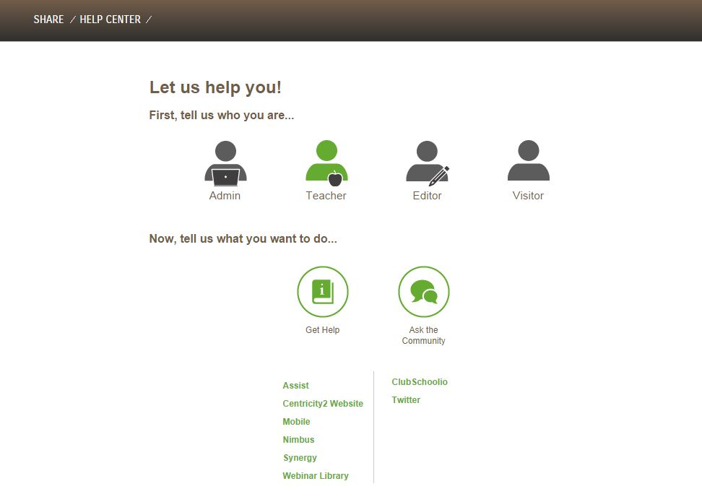
What’s new with Schoolwires – Help Materials: Updated Share Site -
Help Center (cont’d.)
Notes:
Is Persona based (Admin, Teacher, Editor, Visitor) and includes a Curated Search (click on a topic to open the search)

Slide 11
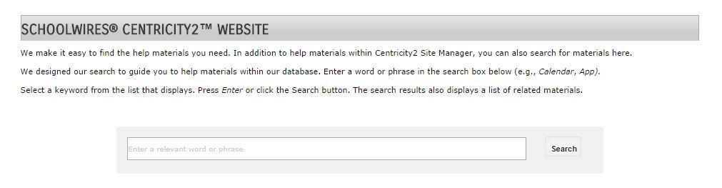
What’s new with Schoolwires – Help Materials: Updated Share site – Curated Search
We would like to introduce you to the Curated Search.
This keyword and context-based search is easily used to find relevant help materials, even when your search criteria is fuzzy.
Notes:
First, enter a word or phrase into the Search box, fewer or more specific words work best. (enter Calendar, hit search; select create calendar event – show items)
A list of suggested topics displays. Select an item within this list—that item then displays in the Search box.
Click the Search button or press the Enter key to display the Share Help Content screen.

Slide 12
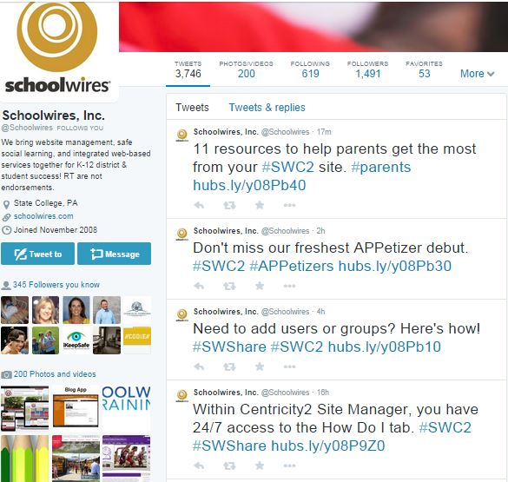
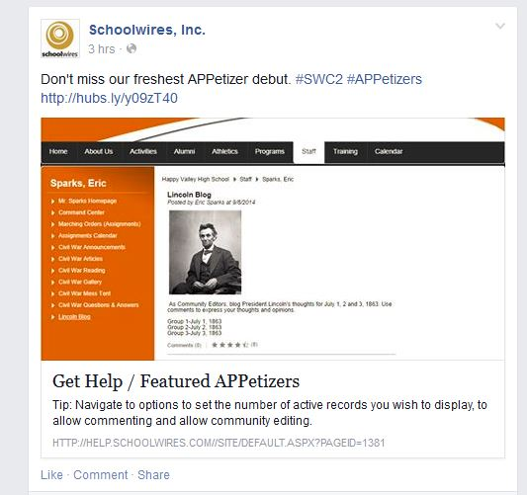
What’s new with Schoolwires – Help Materials: Social Media
  Great way for teachers and section editors to find materials and resources
  Opportunity for conversation with other users
  Share homepage content highlighted
  Guides you to featured materials
  Have fun

Slide 13
What’s new with Schoolwires – 2.8 Release Highlights
Broadcast E Alerts enhancements
  Added Twitter and Announcements as potential communication channels.
  Added the character countdown for text messages.
Updated basic text editor in eight apps.
About Teacher App
Book List App
Discussion App
File Library App
Link Library App
Lunch Menu App
Q &A App
Wiki App
Simplified the App Picker used when adding apps to a page.
Resolved various defects... read the release notes for details.
2.8 release notes and 2.8 release webinar - available on the SHARE site
Notes:
Password reset procedure--reset link (instead of plain text email). This change was made for security purposes. Sending plain text passwords left users’ account vulnerable. Schoolwires will no longer send any passwords. If a user forgets his password, a link to reset is sent. This creates peace of mind for IT administrators and users.
Simplified version of the TinyMCE editor. Any apps that had limited function editors before will be replaced with this simplified version. The previous editor created content that was not mobile friendly. Users no longer have to think about making changes to enable adaptive content – it just works. The tool is simplified and streamlined. The end result looks great on any screen on any device.
Broadcast E-alerts--adding new sending channels ( Twitter, Announcements). This supports the unified authoring experience - from one place administrators can communicate information through a variety of channels . The contact list allows us to send this to parents and others who are not registered users – increasing the distribution of the message. Create once publish everywhere, makes it simple, makes life easier. Unified authoring provides consistency across channels.
Adding reporting—dashboard This feature allows administrators to track the progress of voice calls, texts, and other communications. Knowing the current status provides peace of mind and empowers them to identify any problems early and find a resolution quickly. They don’t have to wonder if the cancellation notice went out. Making sure parents have the information they need means they can plan accordingly.

Slide 14

Questions / Comments
Please direct future questions on products, services and features to the WNYRIC Webs That Work team
  wtw@e1b.org

