Slide 1
Fabulous Forms & Super Surveys
Mindy Gigantelli
Rebecca Zdon
Gloria Queeno-Chamberlain

Slide 2
Agenda
What are Forms & Surveys?
Creating a New Form
Setting Form Options
Viewing & Publishing Forms
The “More” Dropdown
Reports
Item Libraries
Styles

Slide 3
Topic 1: What are Forms & Surveys?
Forms & Surveys allow users to be able to gather important data from their populous, and analyze that data right from C2.
It consists of three major components:
  Style: A style sets the colors and fonts for your form or survey. Each form or survey you create must be associated with a style.
  Items: Items (question types) are the core of your form or survey. They represent the separate pieces of information you are attempting to collect. There are 20 different types of items from which to choose.
  Pages: You may have an unlimited number of items, distributed among an unlimited number of pages on a form or survey.

Slide 4
Topic 1: What are Forms & Surveys?
District Examples of Forms
  Transcript Request
  Tona-E-News
  iPad Application
  Petition
  Website Feedback
  Child Safety Training & Anaphylaxis Training
  Scholarship Application
  Scholar Athlete

Slide 5
Topic 1: What are Forms & Surveys?
Overview of Workspace
Where are Forms & Surveys located?
  Workspace: Site, Channel or Section
    Each Workspace has it’s own unique set of Forms & Surveys.
    Best Practice: Always build your Forms in the workspace where it will be displayed to the general public!
  Tools Tab→Forms & Surveys
    Review Tabs
    Site Workspace has options that you will not find in the Channel or Section Workspace.

Slide 6
Topic 2: Creating a New Form
Review all Item Types
  Handout (11-13 Forms/Surveys Manual)
Create New Form
  Hands-on exercise – Create a Transcript Request Form
    Insert/Copy/Move/Delete Item Types
    Piping
    Page Conditions
    Page Properties
    Page Breaks
Notes:
We will have all the students go to http://c2.swtrain8.schoolwires.net/cms/module/selectsurvey/TakeSurvey.aspx?SurveyID=111 (ask Vicki to create a friendly URL)

Slide 7
Topic 2: Creating a New Form
Tips:
For each type of question, you can choose whether to make the item required. Users will not be able to complete the form without answering those questions.
Be sure not to create too many items on one page. Add multiple pages to minimize scrolling. Users will be able to click next to view your additional pages/items.
When using piping, you must put the piped answer on a subsequent page.
You must change the status of the form to Active to allow data to be entered and recorded.
To Edit an existing form, click once on the title. You may not make extensive edits to a form without first clearing responses. If you need to retain the data, export it before you edit the form.

Slide 8
Topic 3: Setting Form Options
The Options button allows you to change certain behaviors of each individual form.
Review Form Options
  General Options
  Display Options
  Access Options
  Completion Options
  Report Options

Slide 9
Topic 3: Setting Form Options
General Tab
  Name
  Status
  Owners
  Admin Email
  Date Created
  Start/End Date

Slide 10
Topic 3: Setting Form Options
Display Tab
  Style
  Page Numbering
  Question Numbering
  Survey Navigation Buttons
    Back
    Save
    Cancel
  Cancel Button URL

Slide 11
Topic 3: Setting Form Options
Access Tab
  Respondent Access Level
    Authentication
  IP Address Range
  Respondent Submission Options
    Response Type
    Max Number of Responses
    Number of Responses per User
    Days for Update

Slide 12
Topic 3: Setting Form Options
Completion Tab
  Completion Action
  Completion Message
  Completion URL
  Button Display
  Send Responses To

Slide 13
Topic 3: Setting Form Options
Report Tab
  Report Format
  Report Security
  Highlight Responses
Advanced Tab
  Hidden Fields

Slide 14
Topic 4: Viewing & Publishing Forms
Viewing the Form/Survey
  Preview your Form/Survey
  Test your Form/Survey
    Hands-on Exercise!
  Capture the Form/Survey URL

Slide 15
Topic 4: Viewing & Publishing Forms
Sharing the Form/Survey:
  Demo: Place a link directly on a page
    Insert Form Icon
    Insert Link Icon
  Demo: Map a Page to the Form/Survey
    Demo: Create Friendly Web Address Mapping
    To open in a new window insert “target=_blank after the URL
  Email/Share a link to the Form/Survey

Slide 16
Topic 5: More Dropdown
Analyzing Responses
  Will grant you access to an overview of responses within the form/survey.
Clearing Responses – Demo (Don’t Clear Results!)
  Clears any responses so that you can alter and update a form/survey.
Export Form (Hands-on Exercise)
  Can use this to import a form into a different workspace. Useful if you created the form/survey in the wrong workspace.
Delete Form

Slide 17
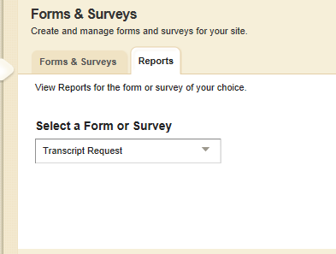
Topic 6: Reports
Reports allow users to analyze their form information from a central location.
Reports Tab – Click the Reports tab to analyze responses.
Select the desired form.

Slide 18
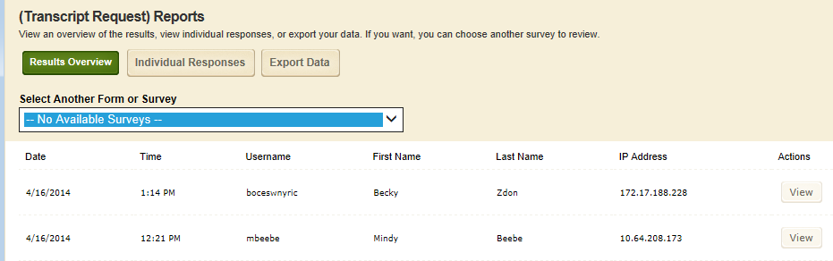
Topic 6: Reports
Viewing Individual Responses
    Click the Individual Responses button or…
    Click the View button next to the response record

Slide 19
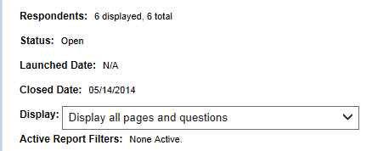
Topic 6: Reports
Viewing the Results Overview
Be sure to set the Display to All Pages and Questions!

Slide 20
Topic 6: Reports
Results Overview
  Manage Filters - Demo
    Click Insert Filter to specify the data for which you are filtering. You may insert more than one filter.
    The Filter will remain active, until it is deleted or inactivated.
  Share Results - Demo
    Report Sharing allows you to specify those with whom you would like to share Overview Results. Share with others who do not have access to Forms & Surveys.
    Be sure to Enable Report Shares!

Slide 21
Topic 6: Export Data
From the Results Overview window, click the Export Data button.
Data will be exported to a CSV file.
You may keep the default settings for the standard export.

Slide 22
Topic 7: Item Libraries
Item Libraries: This allows you to create a set of common questions that you or other users may need to add to a form/survey.
Compare to a “frequently used question” database.
Site and Subsite Directors are the only editors with access to create Item Libraries.
Demo – Create an FAQ Item Library
Notes:
Be sure to make the Item Library PUBLIC or else you will not have access to it…

Slide 23
Topic 8: Styles
Styles: A way to add color and customization to how a form/survey looks on a webpage.
Hands-on Activities:
  Create a Style
  Apply to Transcript Form

